Slide 1

UX/UI Design Principles
My Learning Collection
Anna Shitikova

Slide 2

1. Contrast
In this case, the contrast is created between the background color and the font color.
rgb(225, 220, 203) and rgb(46, 136, 163)
This combination falls closest to the scheme “accent color + neutral”, where the soft beige provides balance and the turquoise stands out, creating visual contrast.
https://portfolio-a8654.web.app/index.html

Slide 3
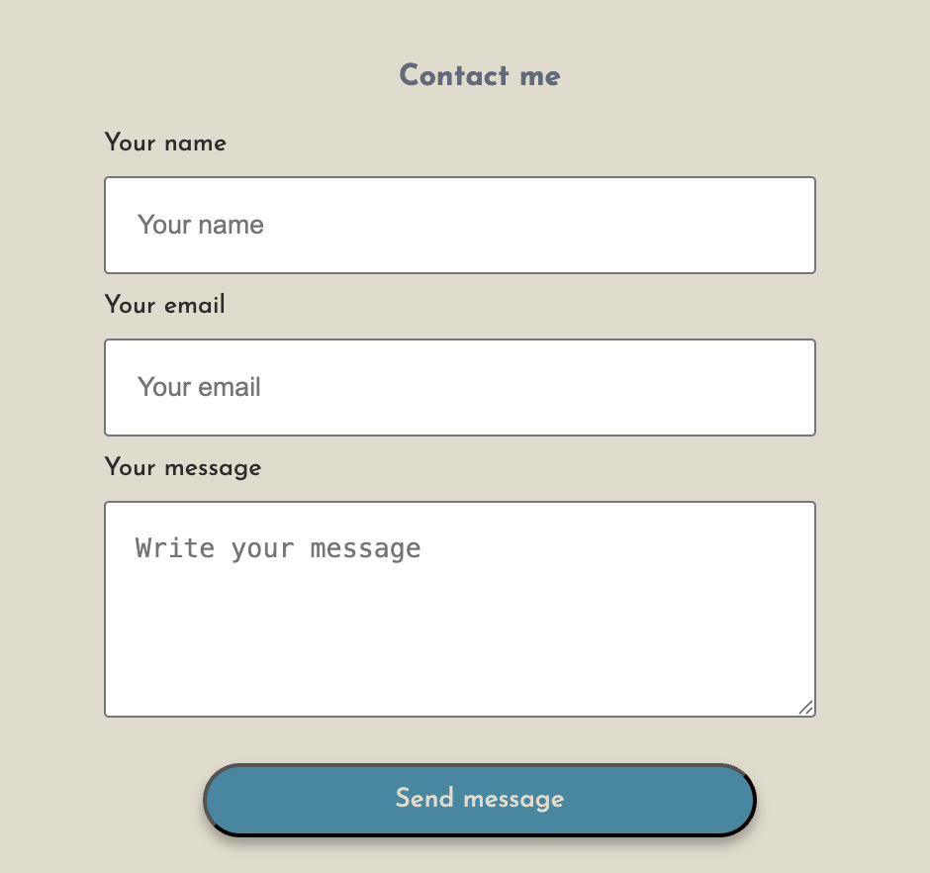
2.Emphasis
Emphasis directs the user’s attention to the most important interface elements, such as a call-to-action button. It is often achieved using color contrast, size, or typography to make the element stand out from the rest of the design.
https://portfolio-a8654.web.app/index.html

Slide 4

3. Hierarchy
Hierarchy helps users understand which elements are most important and which are secondary. It is achieved through font sizes, placement, and visual grouping. For example here, headings, and body text guide users from the most important information to the least important.
https://cv-worker-portfolio.weblium.site/

Slide 5
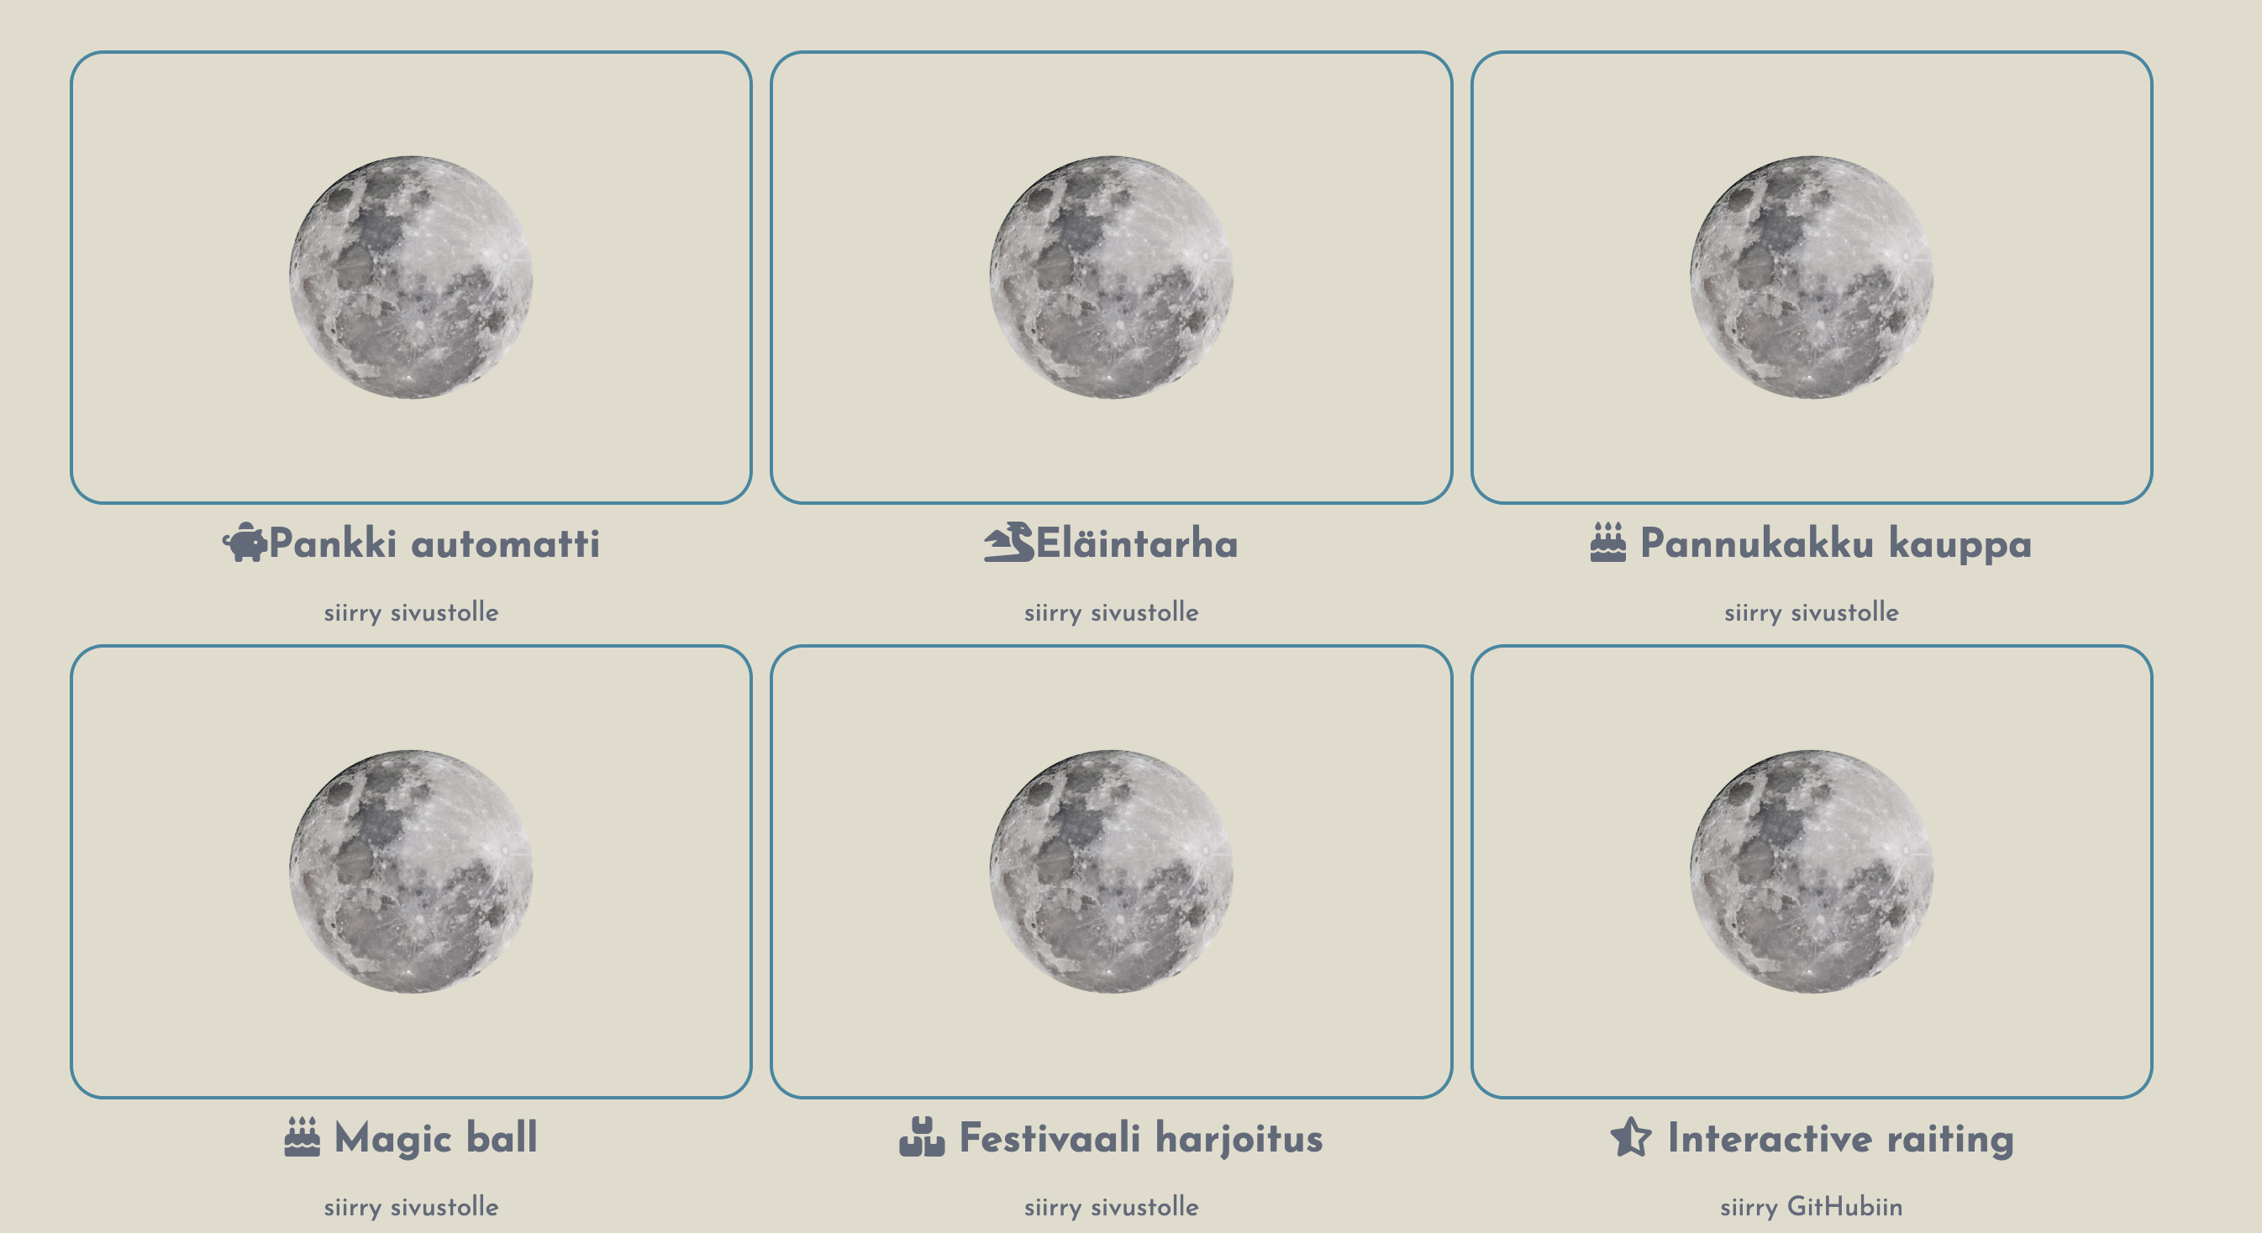
4. Alignment
creates order and neatness in the interface.
When elements are aligned according to a grid system, the layout feels organized and visually balanced.
In this example, grid systems are used to ensure consistent spacing and proper placement of elements.
https://portfolio-a8654.web.app/index.html

Slide 6

5. Repetition
enhances the recognizability and consistency of the interface.
This can include a repeating color scheme, consistent button styles, or uniform icons.
In this example, the same color scheme is applied across different pages, creating a cohesive visual experience.
https://portfolio-a8654.web.app/index.html

Slide 7
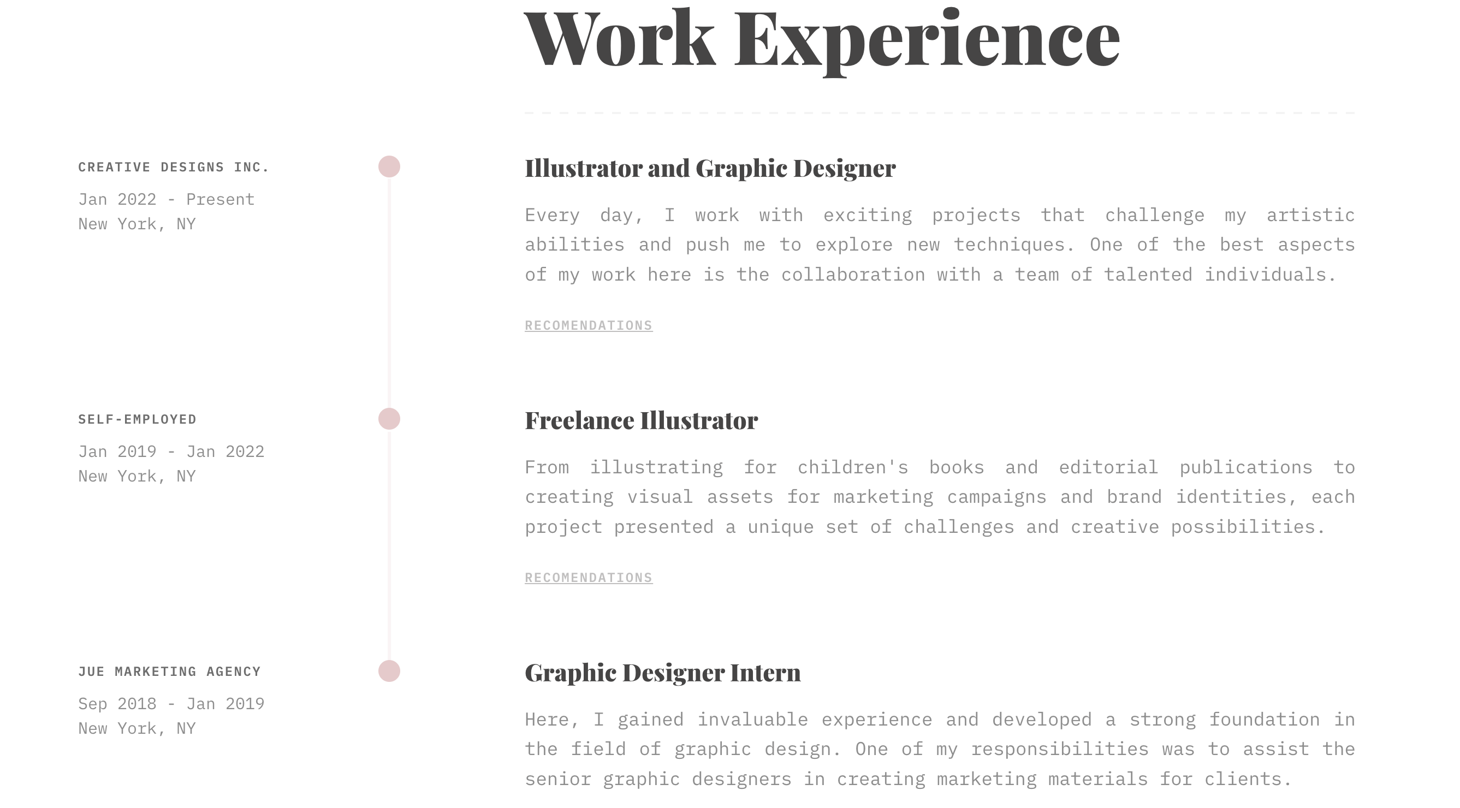
6. Balance
is the even distribution of objects, colors, textures, and space within a design.
It creates stability, harmony, and structure.
In this example, the text on the page follows the Golden Ratio and is divided into two parts according to this principle, achieving a visually balanced layout.
https://cv-worker-portfolio.weblium.site/

Slide 8
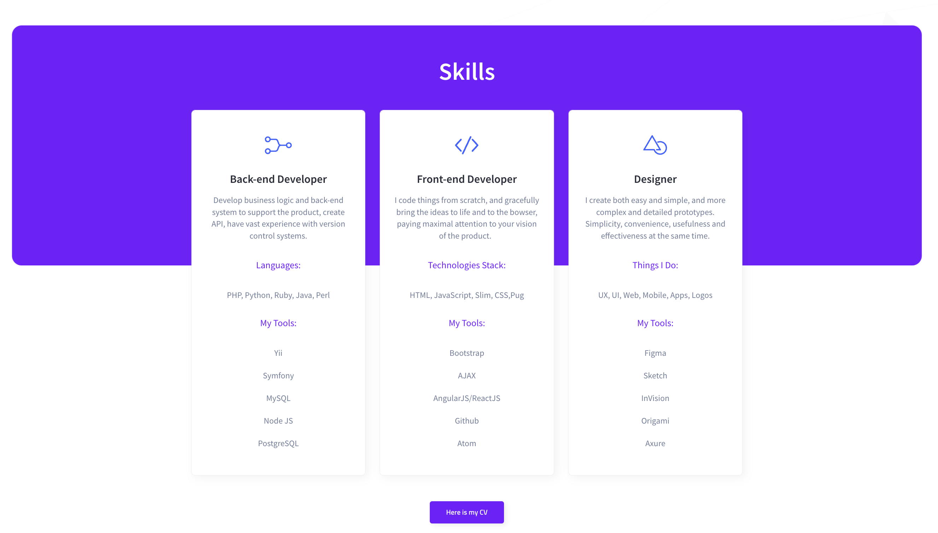
8. Proximity
that elements belonging to the same group should be placed close to each other. This helps users logically combine information and find what they need faster. In this example, groups of elements are connected logically, making the interface easier to understand.
https://developer-cv.weblium.site/

Slide 9

9. White Space
White space creates “breathing room” between elements, making the design clean and organized. It helps guide the user’s attention to the most important parts of the interface.
In this case, the designer focuses attention on key text by keeping the design simple—using only font and background without unnecessary clutter.
https://kylecraven.design/

